Slide 1


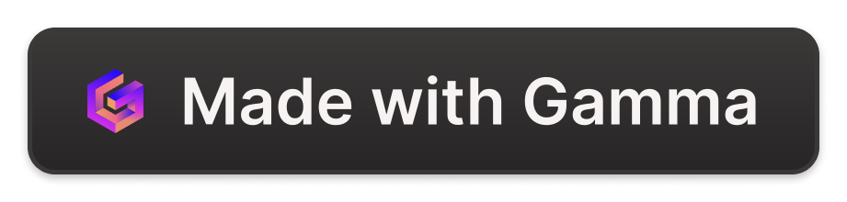
AWS by Vidyasagar VB
V
by Vidyasagar VB

Slide 2

Day -01 Introduction
Day -02 Iam and MFA
Day -03 Iam user, group and policy

Slide 3
Day -04 AWS CLI and Introduction to EC2
Creating IAM Users and Groups
Create an IAM User
Create an IAM user.
Assign the necessary permission policies.
Go to the Security Credentials section and create an access key.
Select "CLI" as the use case for the access key.
Configure AWS CLI using the command prompt.
Verify the AWS CLI installation by running the command aws --version.
Configure the AWS CLI by providing the access key ID and secret key.
Create the IAM user by running the command aws iam create-user --user-name.
Go back to the AWS Management Console and refresh to see the newly created user.
Create Groups
To create groups, run the command aws iam create-group --group-name.
Introduction to EC2
Create an Instance

Slide 4
Day -05 AWS security group, instance type, webserver
Create an instance.
Add a security group.
Choose the instance type (t2.micro).

Slide 5
Day -06 Webservers and Putty
Launch an instance using Apache2 server.
Download Putty and PuttyGen.
In PuttyGen, add your key pair.
Convert your PEM file to PPK format using PuttyGen.
Open Putty and add the host name and IP address.
In SSH authentication, pass the private key path and open the session.
In Putty, login as "ubuntu" and hit enter.
You should now be logged in to your instance.

Slide 6
Day -07 User data script , WinSCP and OpenSSH
Launch an Instance (Using Apache2 Server)
In the advanced settings, go to "User Data" and enter the following script:
#!/bin/bash
apt update -y
apt install apache2 -y
systemctl restart apache2.service
echo "<h1>This is my user data script</h1>" > /var/www/html/index.html
Download WinSCP and add the hostname and username. In the authentication settings, click on the "Advanced" button and pass the private key file. Just drag the file and drop it.
Download OpenSSH and run the instance.

Slide 7
Day -08 EBS Volumes and Snapshots
Launch an EC2 instance
Create a volume
Connect to the EC2 instance
Run the command df -h or lsblk to check the available internal disk space
Attach snapshots

Slide 8
Day -09 AMI and Autoscaling groups
Launch an instance
Go to the instance ID actions and select "Create Image" to create an image template
Launch an instance from the created AMI
Create an Auto Scaling group
Create a launch template

Slide 9
Day -10 ELB
Launch 2 instances named server1 and server2
Create a load balancer
Create a target group

Slide 10
Day -11 ASG with ELB and Elastic IP
Create an Autoscaling group
Create a launch template
If a load balancer already exists, go to Load Balancing and click "Attach to an Existing Load Balancer"
Select application load balancer as the load balancer type
Day -12 Introduction to S3
Create a new bucket
Enable Object ACL's
Disable bucket versioning
Choose SSE-S3 as the encryption type
Disable bucket keys
Go to Objects and upload the file
If you want to give public access, untick "Block all public access"

Slide 11
Day -13 S3 static website hosting, encryption, bucket versioning, and storage classes
Create a bucket
Upload the files to the bucket to host a static website
Go to properties and enable static website hosting
Check the location of the index.html file
If you encounter a 403 forbidden error, make sure the bucket policy allows public reads
Go to permissions and make the bucket policy public
In the actions section, select "getobject"
Pass the ARN and generate a policy
Go to bucket versioning and enable it

Slide 12
Day-14 S3 CLI and Cloudfront
Launch an instance
Create an IAM user
Connect the instance
Install AWS CLI in Ubuntu
Go to AWS CLI installation and copy the provided curl command into the command prompt
First, run "apt install unzip"
Then, unzip AWS CLI
In the meantime, create an access key and secret key for the user
Create a CloudFront distribution
Go to the S3 bucket, select a bucket, and go to permissions to add a bucket policy

Slide 13
Day -15 AWS Lambda
Go to Lambda and create a function
Go to IAM roles and set up access permissions
Day -16 Amazon EFS and Amazon SSM
Launch an instance
Go to File Systems, click on EFS, and create a file system
Create a role in IAM and click on AWS service
In the use case, select EC2 role for AWS Systems Manager
Go to instance actions, click on security, and modify the IAM role
Stop the instance and restart it
Connect to the instance

Slide 14
Day -17 Amazon RDS
Download SQLyog and install it
Create a database
Day -18 Route53 and Amazon Trusted Advisor
Click on "Register Domain" and search for a domain
Purchase a domain name
In DNS management, create a hosted zone
Click on "Type" and select "Public Hosted Zone"
In "Availability Monitoring", create a health check
Interview Question
What is the difference between Aname and Cname?
Aname record points a name to a specific IP address.
Cname record points a name to another name.
Can we purchase a domain name which is already purchased by someone?
No, we cannot purchase a domain name that is already purchased by someone.

Slide 15
Day -19 Amazon Virtual Private Cloud
Creating VPC
10.0.0.0/16
Creating IGW
Attach IGW to VPC
Creating Subnet
10.0.1.0/24 and 10.0.2.0/24
Enabling public IP in the subnet
Create a public route table to IGW

Slide 16
Day -20 NAT Gateway
Create CloudTrail
Storage location – If an S3 bucket already exists, use it. Otherwise, create a new S3 bucket.
Log file SSE-KMS encryption – No
CloudWatch logs - Optional, if needed
Events – Accept all
API activity – Read & write
Insights events
API call rate – Yes
API error rate – Yes
Create IAM user and search in the event history
Create a NAT gateway
Launch a private EC2 instance

Slide 17
Day -21 VPC Peering
Create VPC
VPC only – Yes
IPv4 CIDR – 10.0.0.0/16
IPv4 CIDR block – Option 1
IPv6 CIDR block – Option 1
Create subnet
Create route table
Launch EC2 instance
VPC peering connections
Day -22 CloudWatch
Create custom dashboard
Create log groups
Create alarms

